Slide 1
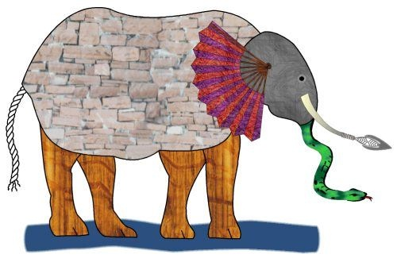
Dharma and Deity Upper KS 2

Slide 2
https://www.youtube.com/watch?v=Vn9BUfUCL4I

Slide 3
Think-Pair-Share
Were the blind men wrong?
Were they right?
What do we need to take from the poem? What is the message?
Do you think the message is true?
Would it be good if everyone remembered this message in their own lives?

Slide 4


Slide 5
https://www.youtube.com/watch?v=VglGNNr1bok

Slide 6
Ahimsa
This is one of the most important Hindu beliefs
It basically means we must do our best not to hurt or harm anyone or anything, but treat them with respect.
The reason is that “God (or spirit) shines in the yes of every living thing, including our own, so when we hurt anyone we are actually hurting ourselves. It is foolish to needlessly hurt other living things.”
Instead of hurting living things, we should show respect because it is the same God (or spirit) that live sin all of us.

Slide 7
https://www.youtube.com/watch?v=87hsmANrNn8

Slide 8
An Acrostic Poem for Ahimsa
An acrostic poem is a type of poetry where the first, last or other letters in a line spell out a particular word or phrase.
Use the acrostic poem template for AHIMSA to write a poem about the meaning of the teaching.

Slide 9
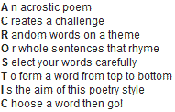
Example of Acrostic Poem

Slide 10
Holi
A Hindu Festival of colours

Slide 11
What is Holi?
Holi is a Hindu festival held in the spring celebrated mostly in India.
It’s a time when people remember when good triumphed over evil.

Slide 12
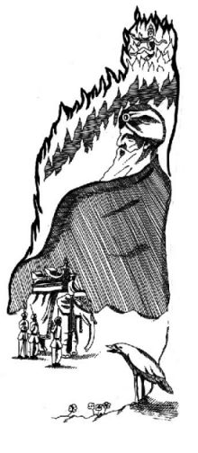
The story of Holi
A long time ago, In India, there was a king called Hiranyakashup who had a son called Prahlad.
The king wanted everyone to think of him as God and to worship him. As Prahlad grew up he realised that this was not true and refused to worship his father. He worshipped Vishnu, a real God.

Slide 13

Hiranyakashup was very angry and punished his son. However Prahlad still refused to worship him and so the king decided that his son must die. The king tried many different ways to kill Prahlad.

Slide 14

He was put in a pit full of snakes, he was beaten by soldiers and he was trampled by elephants, but each time he prayed to Vishnu and he was saved.

Slide 15

The king’s sister, Holika, agreed to help the king. She was thought to have magical powers which made her fireproof. Holika took Prahlad to the top of a bonfire and the bonfire was lit. Holika expected Prahlad to die. Instead, it was Holika who died and again Prahlad was saved.

Slide 16
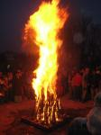
Prahlad felt sorry for Holika and promised to name the festival after her.
Every year, at the time of Holi, Hindus light bonfires to remind them of this time when good triumphed over evil.

Slide 17
Meaning of the story
The story can teach us something about Ahimsa. Here is what a Hindu told a group of pupils about the story:
“It reminds Hindus that we should use whatever gifts we have to help others not to hurt others.”
Which part of the story illustrates this best?

Slide 18
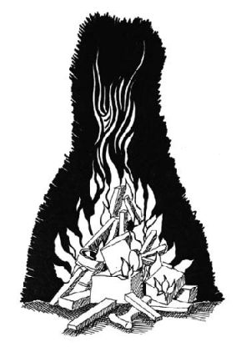
How do Hindus celebrate Holi?
Last year’s rubbish is burned so that people can make new beginnings.

Slide 19
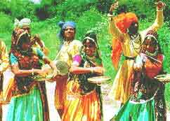
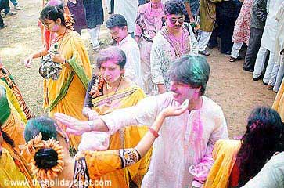

Festival processions and dancing take place.

Slide 20
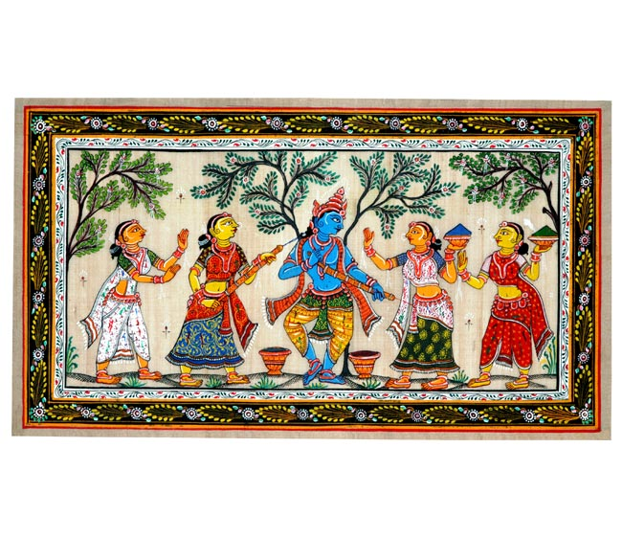
Hindus also celebrate another story about a boy called Krishna. He used to play tricks on maids like throwing paint at them.

Slide 21
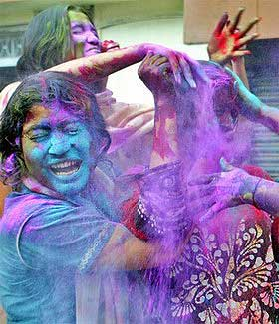
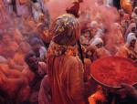
People throw coloured water or paint at passers by.
People are allowed to be rude to those they normally respect. For instance, pupils may throw things at teachers!!!

Slide 22
https://www.youtube.com/watch?v=Dnc2NQ8uPRQ

Slide 23
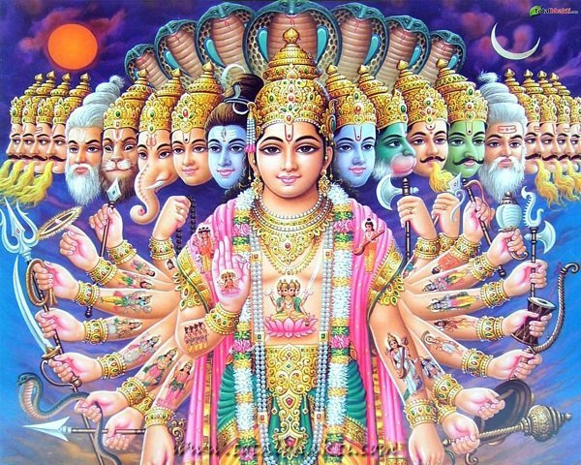
Hinduism Assessment
Upper KS2

Slide 24
https://www.youtube.com/watch?v=Hfhka-OvLSA

Slide 25
Assessment
Write 5 questions for the class which you think covers the 5 most important things we have studied about Hinduism
Don’t forget the answers!
Shall we ask the rest of the class?

Slide 26
Making Connections
12 words associated with Hinduism
Need to pair up the idea with a linking concept.
Connecting ideas must make sense- I am judge.
Only use words once
1 point per connection
2 points for connection no one else made.

Slide 27
Brahman | Vedas | Namaste
Atman | Ahimsa | Holi
Moksha | Reincarnation | Dharma
Sanatan Dharma | Samsara | Karma

Slide 28
Plenary
Read out connections.
If you/your group has the same two words connected words AND connected ideas raise hand.
Questions to think about:
Any words that cannot be connected? Why?
Is it easier to work with others?
What did you like/not like about the game?
Would playing the game a lot make you better at it?
What did you learn?

