Slide 1
Eternal Truths

Slide 2
Rules
Get into groups of 4/5
Place the cards face down on the table
Each person takes two cards and reads it without showing it to the rest of the group.
Each person decides whether or not they think the cards are eternal truths (something which is and will always be true)
In pairs talk about the cards you have got and agree whether or not you think these are eternal truths.
In 4s now consider the cards and discuss which cards are eternal truths.
Do the same with the rest of the cards

Slide 3
The goal is to share with the rest of the class the cards you think are eternal truths and why.
What makes something an eternal truth? Why are some not eternal truths? Are some more difficult to agree? Why?
Can you think of any other eternal truths?

Slide 4
What is Hinduism?
Strange fact 1: Hindus prefer NOT to call their religion Hinduism. Why?

Slide 5
Why?
Strange Fact 2:The word Hindu comes from the name of an ancient river in Northern India called The Sindhu properly. The Persians who invaded the area could not pronounce the word and pronounced it Hindu. The people who lived in that part of the world became Hindus. They called the region beyond the river ‘Hindustan’.

Slide 6
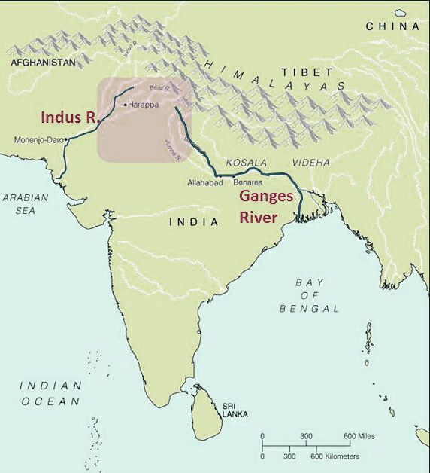
Map showing River Indus (Sindhu)
Notice River Ganges

Slide 7

When the Muslims invaded around 1,000CE they called anyone who was not a Muslim a Hindu.
These are people who share sacred texts called the Vedas and other Sanskrit sacred writings. (Sanskrit is the language they are written in).

Slide 8
Hindus call their religion ‘Sanatan Dharma’
Sanatan Dharma means ‘eternal truths’
For many Hindus their religion is beyond time and space, it is the eternal truth, without a founder.
These truths are all about how we behave, which is why some Hindus say the way we treat each other is just as important, or even more important, than how much we worship.
These Truths were written down in the Vedas.

Slide 9
Another way to think of Dharma is ‘duty’
Hindus believe we each have a duty, which we should follow.
What do we mean by duty?

Slide 10
Your duty as a pupil
On a piece of sugar paper draw an outline of a pupil.
Inside this outline write all the things pupils are supposed to do and be like: eg follow school rules; want to learn; try hard etc….
Try to write as many as you can.

Slide 11

Help others who are having difficulty
Want to learn
Be curious

Slide 12

What happens when you follow do your duty?
Look at your list again. What are the consequences of following or NOT following your duty?

Slide 13
https://www.youtube.com/watch?v=4mGhRW0UtKg

Slide 14
The Law Of Karma
The word ‘karma’ means ‘action’
The Law of karma says that everything we think, do or say will produce certain results.
For example, if we do good things, good things will happen to us.
Sometimes the results of what we do catch up with us immediately, sometimes they take a long time.
This is not a punishment or reward from God, it is a natural law. It is just the way things are.
We can’t escape the law of karma just like a stone thrown into a river will produce ripples.

Slide 15
“The future depends on what we do in the present”
Mahatma Gandhi

Slide 16
Things to think about:
Do you think the belief in the Law of Karma would affect how Hindus live their lives?
If so, how?
Can you think of any examples from your own life in which things you have done have had equal affects (something good happened after you did something good?)

Slide 17
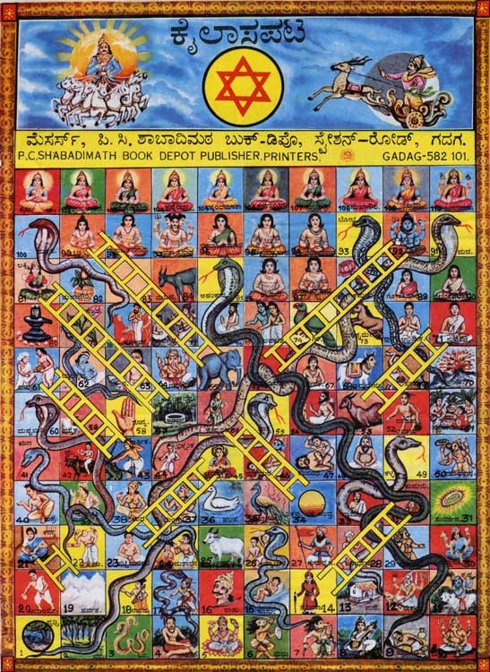
Snakes and Ladders
The game of snakes and ladders was originally called “Gyan Chaupar” and is over 2,000 years old. It’s name means ‘the Game of Knowledge’.
It was originally a game used to explain the law of karma.
It is made up of squares which are either vices (like jealousy), which move the player down the board.
Or virtues (charity) which move the player up the board

Slide 18
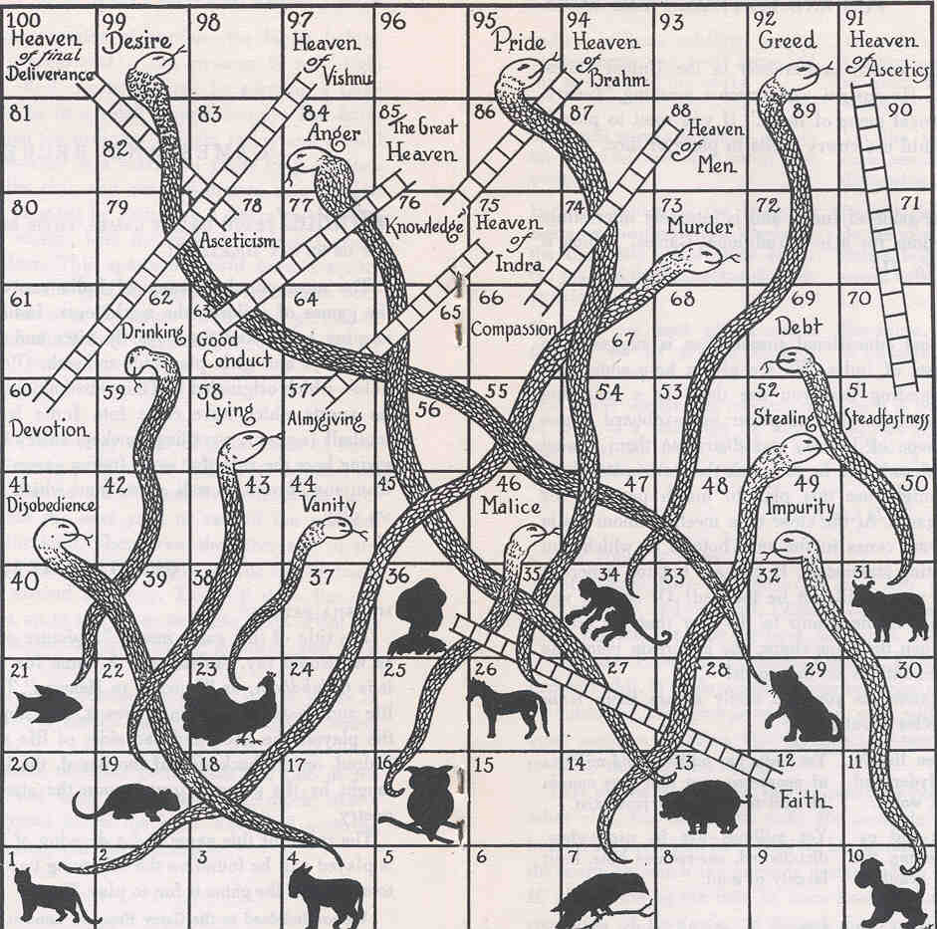
In the original game there were a lot more snakes which represents the idea that it is easier to be tempted to do a vice.
Also the each virtue and vice has an effect which corresponds to how bad it is: so murder (73) is very serious and takes you right back to the start. Vanity (44) is not so serious!
Virtues have a similar opposite consequence.

Slide 19
Create your own ‘Gyan Chaupar’ game
1. Decide which virtues and which vices you will have on the board. You need about 8/9 vices (things which will have negative effects) and about 5/6 virtues (things which will have positive effects).
2. Remember you need more vices than virtues (why?)
3. You now need to decide how serious they are: ie what will the consequences be? For things which are more serious vices the further you fall; the better the virtue the higher you go on the ladder.
4. Label the squares, remember to leave enough space if the vice is going to have serious effects.
5. What are you going to label box 64?
6. Play the game with a dice. How well does it play?

Slide 20

What did you call square 64?
Gyan Chaupar is a religious teaching tool.
Do you notice how some squares have outlines of animals?
Look at square 36, which is the ‘highest’ animal?
The squares represent the Hindu belief in Reincarnation

Slide 21
https://www.bbc.co.uk/programmes/p02n5v2q

