Slide 1
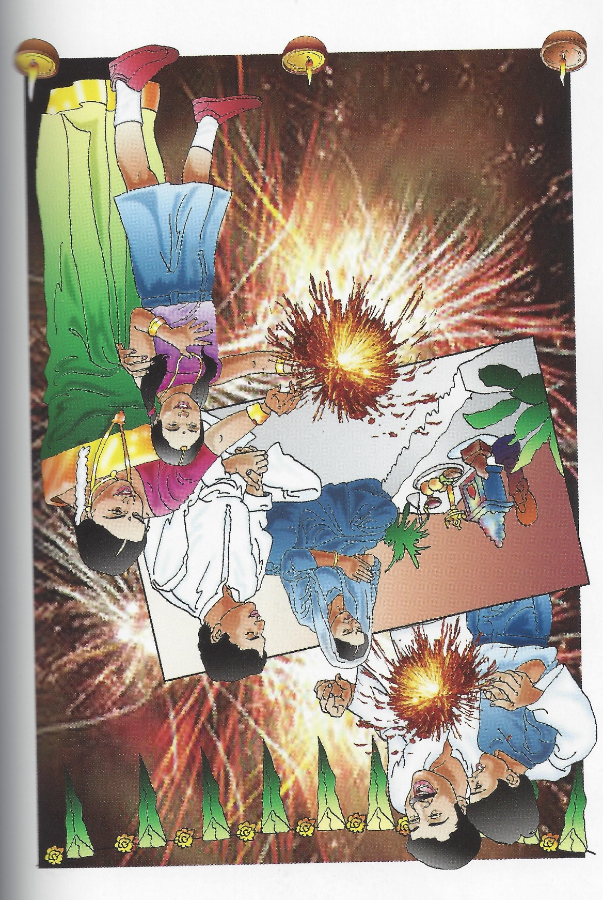
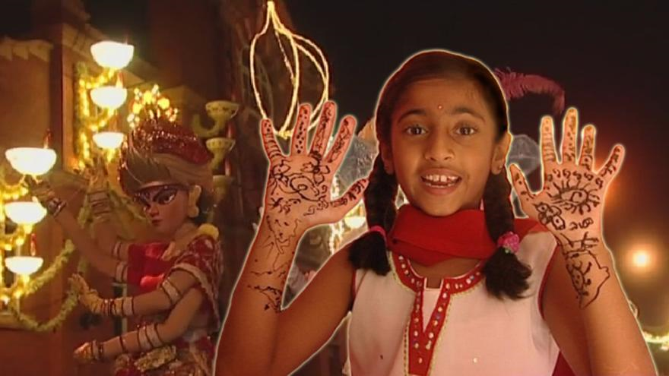
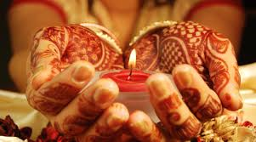
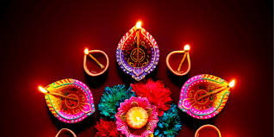
Divali
Notes:
What can you see on this collage?

Slide 2
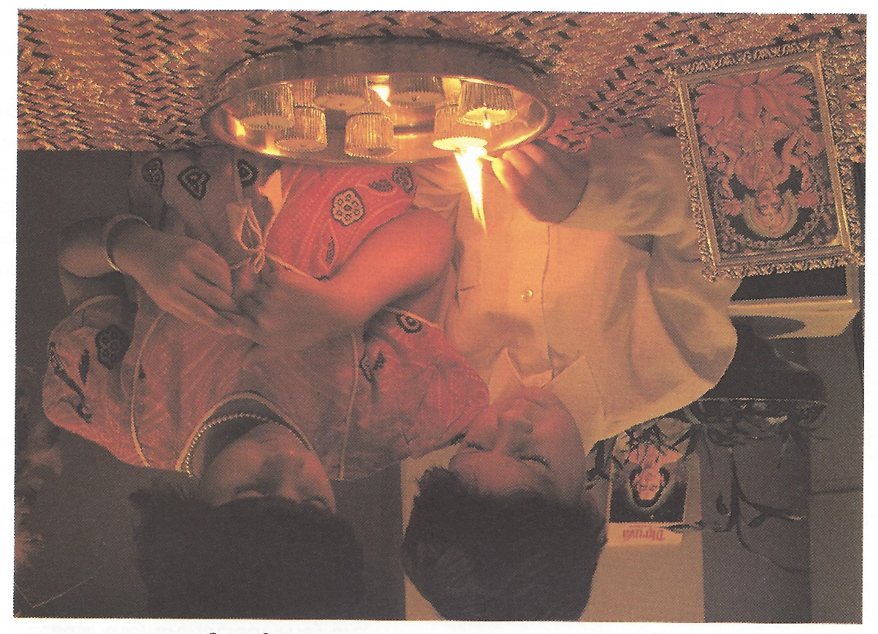
Notes:
Can you see the picture of the Goddess? Lakshmi

Slide 3
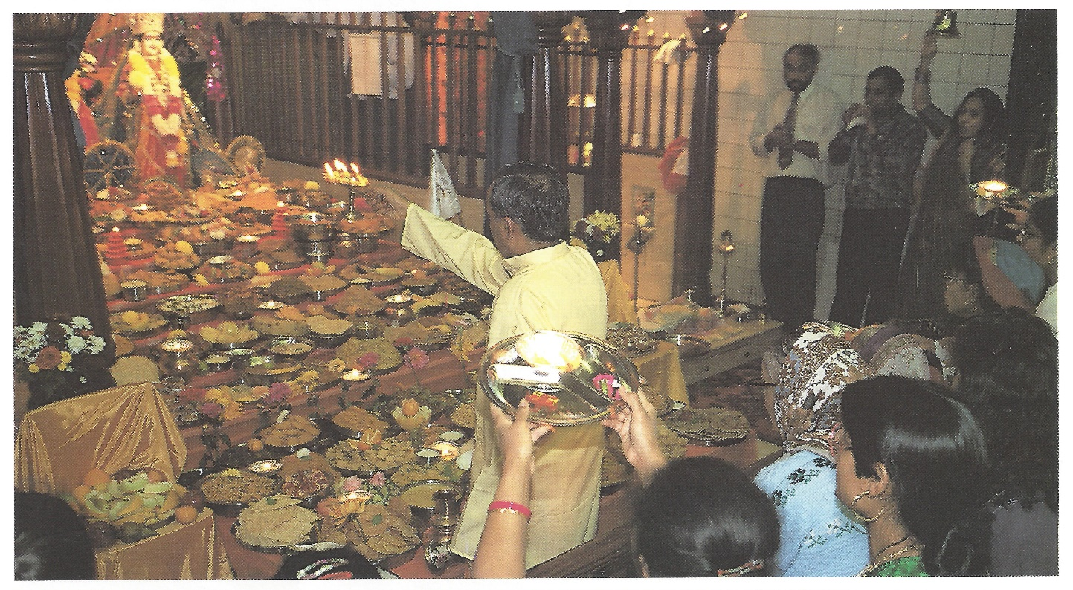
Notes:
Food being offered and then shared at the Mandir

Slide 4
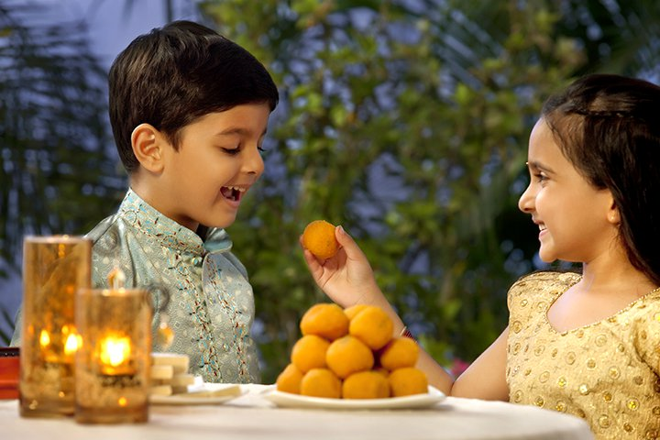
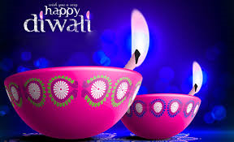
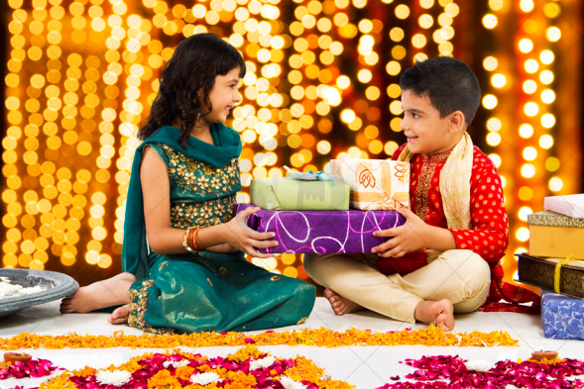
A time for giving
Notes:
Cards, gifts, sweets.

Slide 5
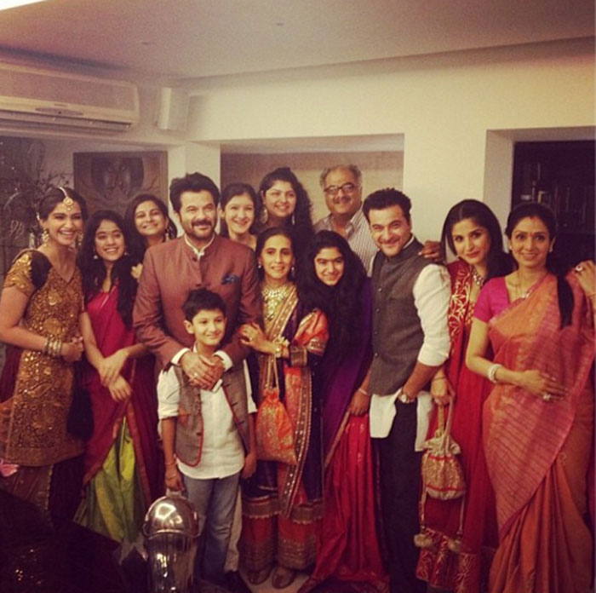
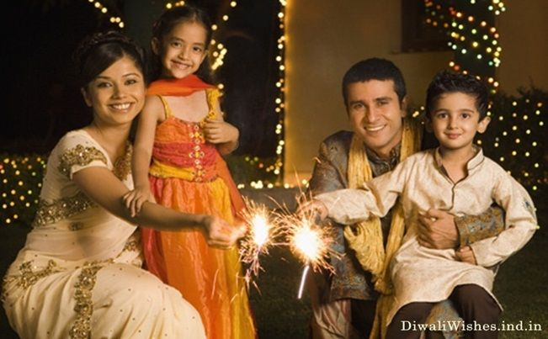
A time to be together …
Notes:
Families come together or contact is made if they are too faraway.

Slide 6
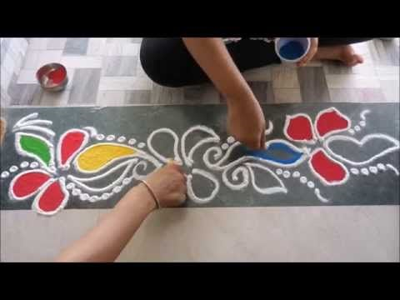
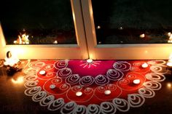
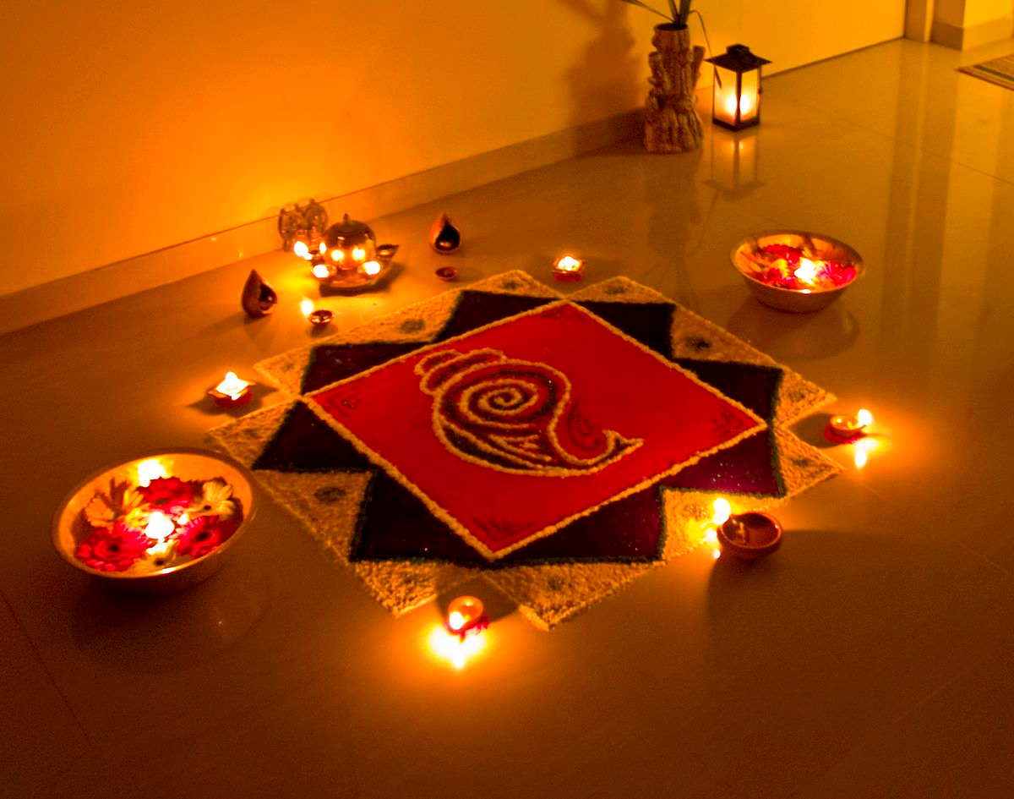
Special customs for celebrating
Notes:
Rangoli patterns welcoming Lakshmi

Slide 7
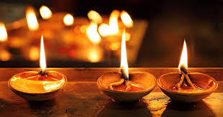
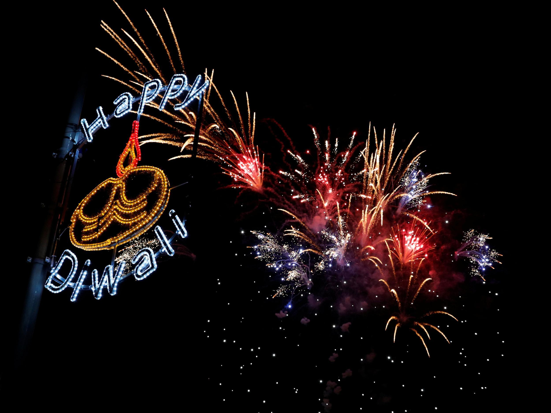
Light is an important symbol
Notes:
Diwa lamps are traditional, but electric light are just as common now. Fireworks celebrating the defeat of Ravana and the return of Rama and Sita: the defeat of evil by good.
Are there any other reasons light is important?

Slide 8
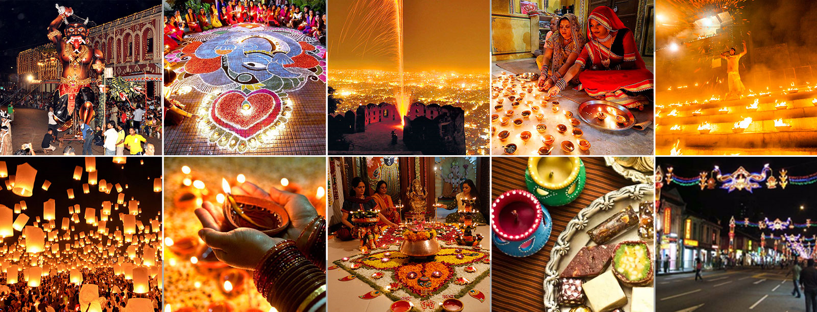
Celebrations in India

Slide 9
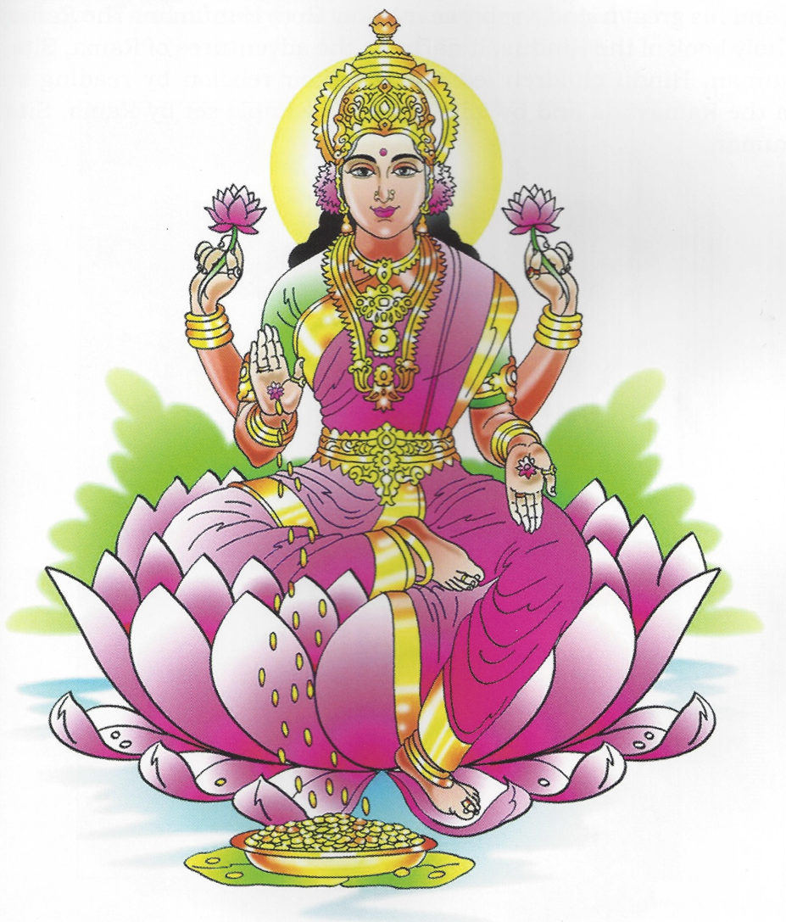
Lakshmi is a welcomed visitor

Slide 10
To think about….
Why do you think the festival is so popular?
Would you like to take part in the festival?
Is it important that people come together at festivals? Imagine a Hindu who lives in a place where there are no other Hindus. Do you think they could celebrate the festival? Would it be as good?
Notes:
Try to bring out the sense of community and belonging sharing a festival can generate. A sense of belonging is important to religious communities: sharing the same beliefs, remembering the same stories, and celebrating in the same way.

