Slide 1
Hindu Gods

Slide 2
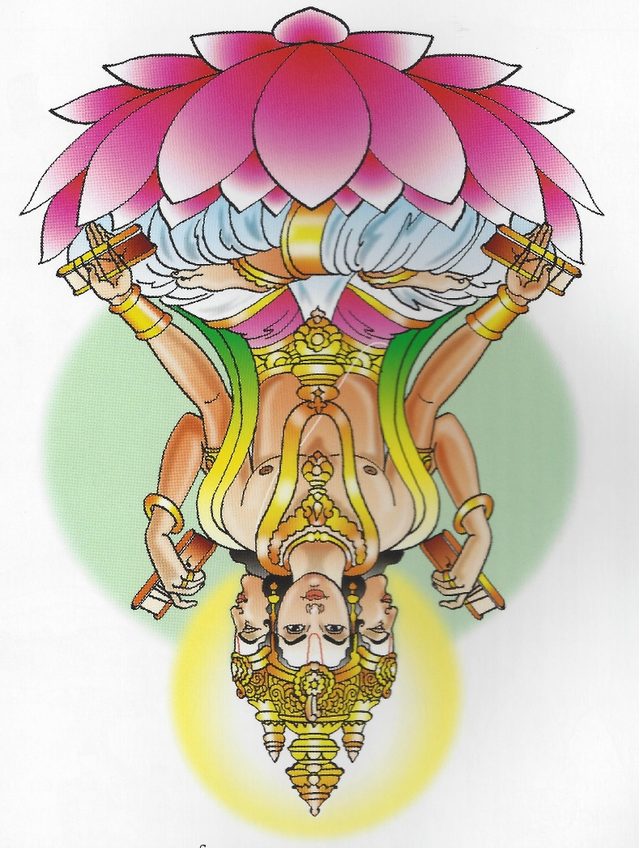
Brahma
When Hindus think of God as a person who is responsible for creating the universe, they call him Brahma.
He is shown with four heads to see in every direction. He has four arms and holds holy books. He sits on a lotus flower

Slide 3
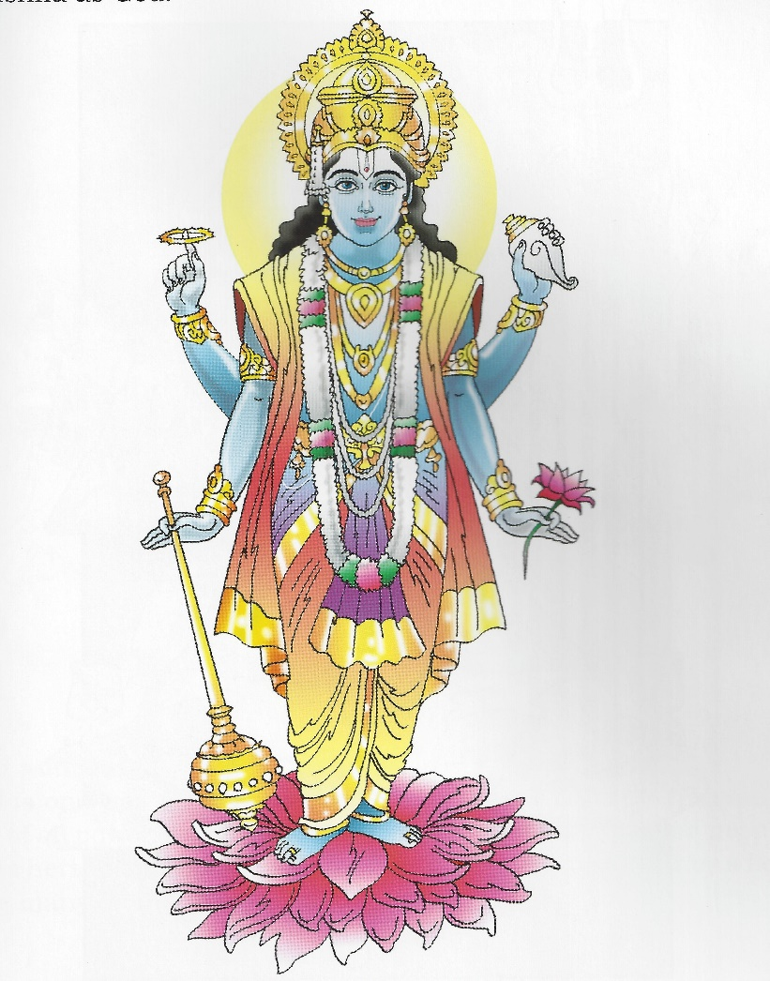
Vishnu
When Hindus think of God as a person who looks after the world, they call him Vishnu.
When Vishnu is born on earth he is called an avatar. He comes to teach people about religion and protect people.
Two famous avatars are Rama and Krishna. Many Hindus worship Rama and Krishna as God

Slide 4
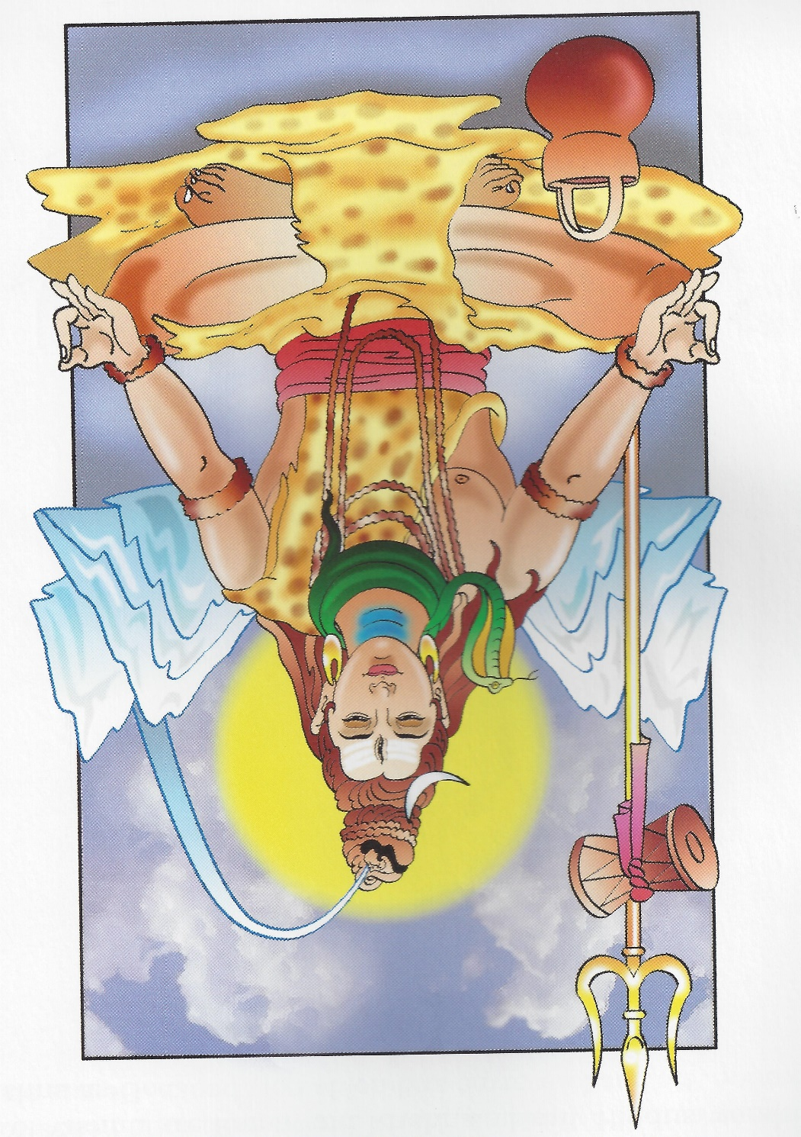
Shiva
Some Hindus like to think of God as both creator and destroyer of the universe.
Shiva is shown sitting in meditation.
The river Ganges streams out from his hair and a snake is curled around his neck.

Slide 5
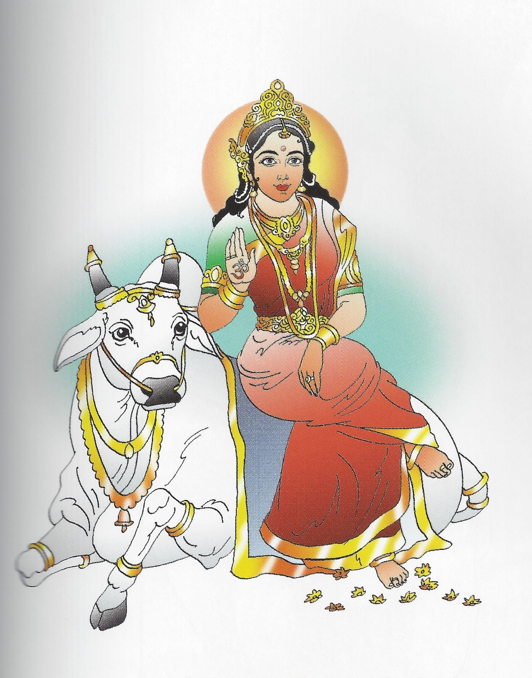
God as a mother
The Mother Goddess is the source of all power and strength. She may be seen in different forms:
Parvati is one way to think od God as the mother Goddess.
Parvati is the source of all power, Shakti.

Slide 6
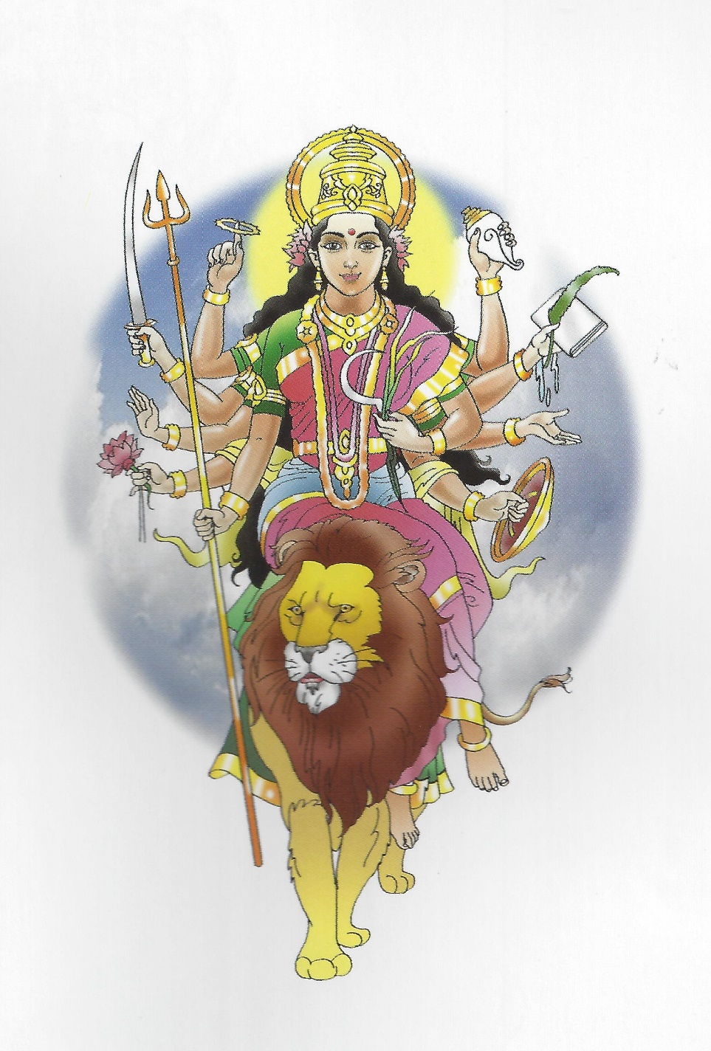
God as a mother
When she wants to destroy wicked people, she changes herself into Durga.
Durga is shown sitting on a tiger or a lion and holding many divine weapons to fight evil.

Slide 7
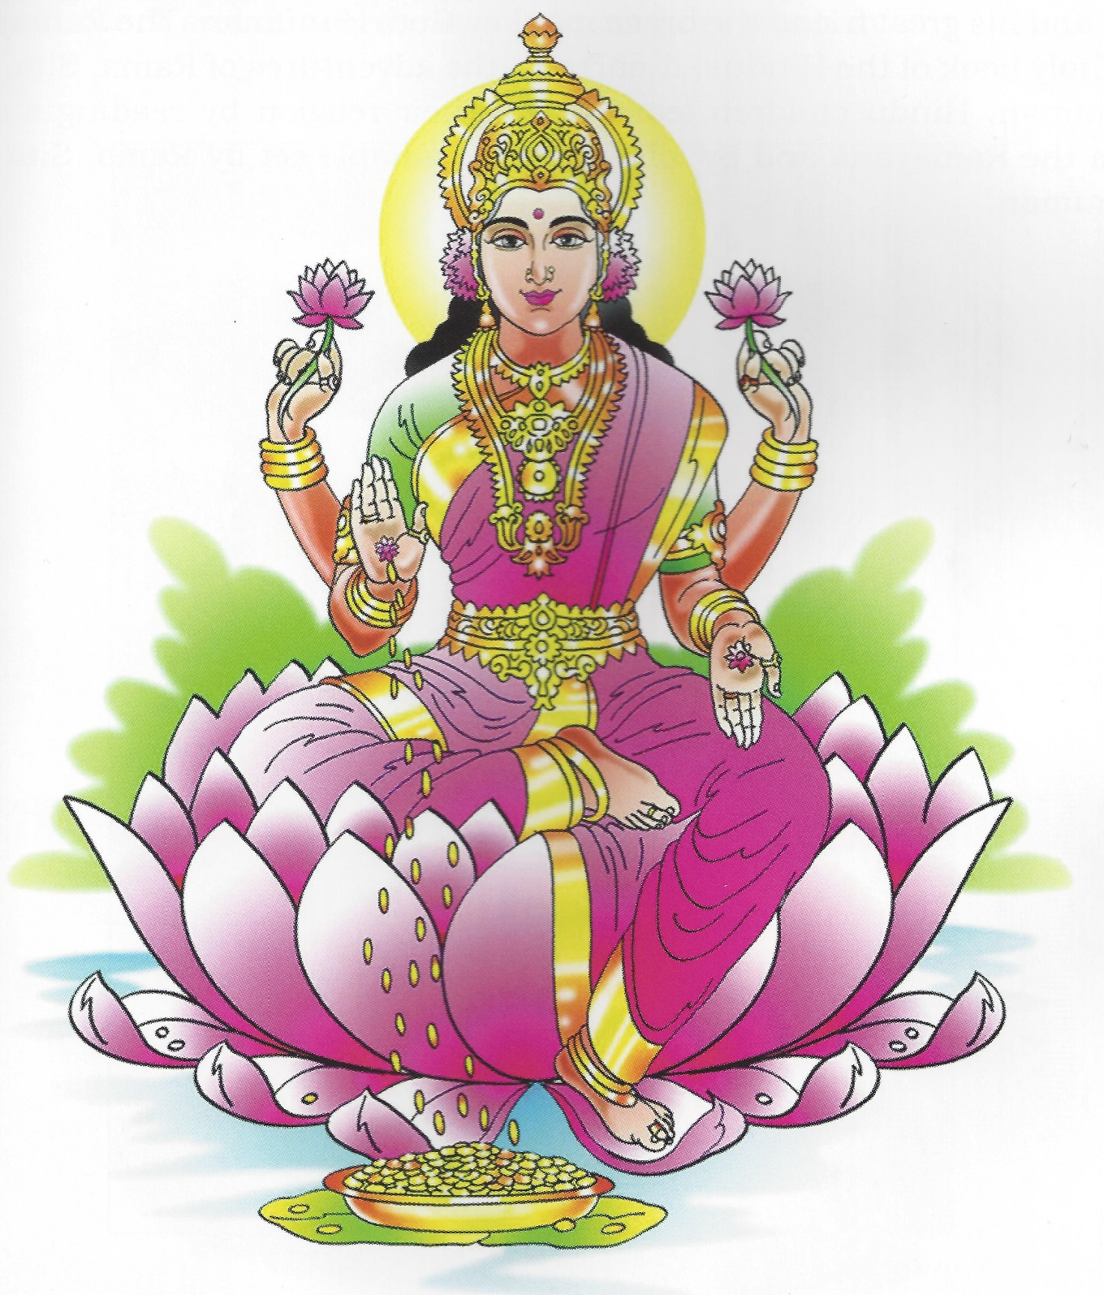
God as a mother
Lakshmi
Another way to think of God as mother is as Lakshmi (Not to be confused with Lakshman, Rama’s brother, in the story).
She is the Goddess of wealth and beauty.
She wear red or pink sari and offers coins to devotees.
She is often shown sitting on a pink lotus flower

Slide 8
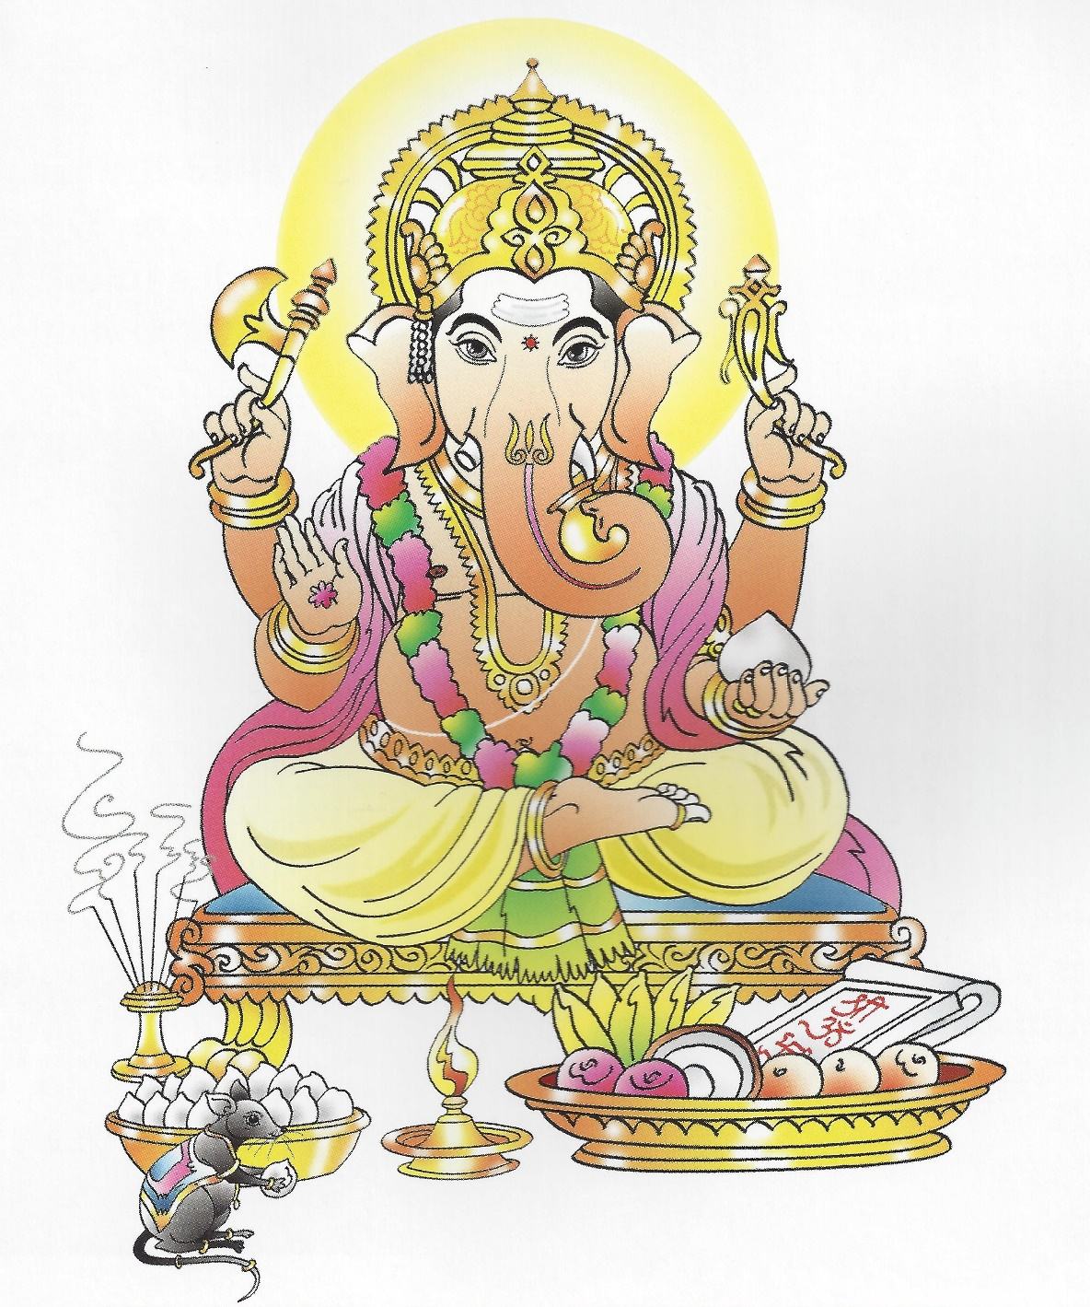
Ganesh
Son of the Mother Goddess Parvati.
Protecting his mother in battle, his head was chopped off. To save his life his mother had to quickly replace his head with an elephants head.
Hindus always worship Ganesh first because he removes obstacles and brings good luck.
They worship him before they start anything new- like starting a new school, or starting a journey, or celebrating a festival.
Ganesh is brave and wise.

