Slide 1
Visiting a Mandir

Slide 2
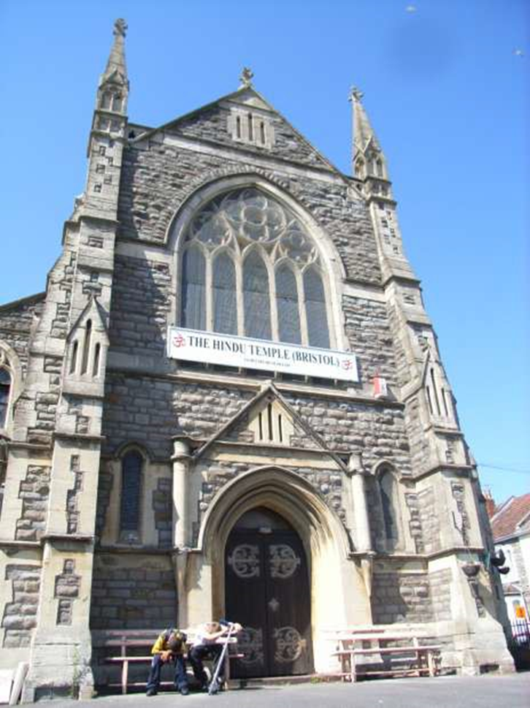
Mandir: A Hindu temple This is a converted church in Bristol.

Slide 3
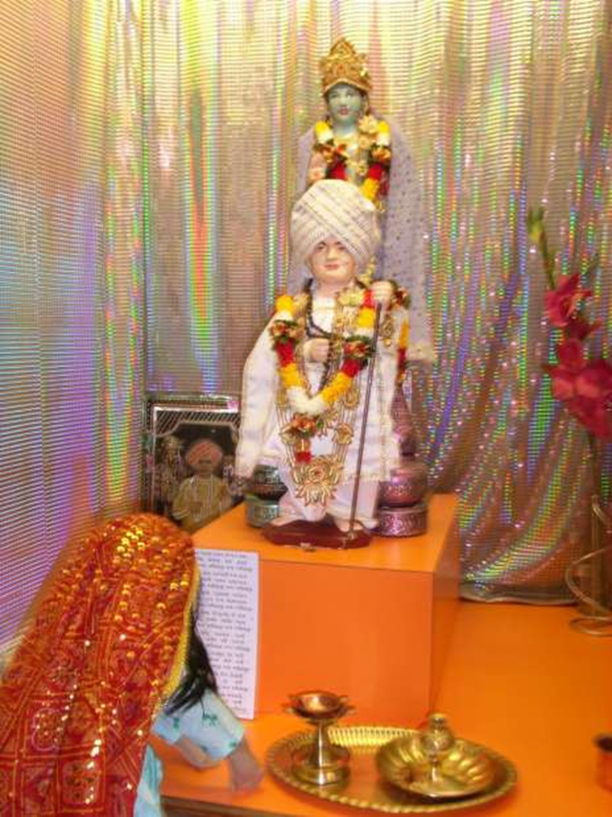
Shrine:
A special place in a Hindu home or Mandir where Hindus pray to God.

Slide 4
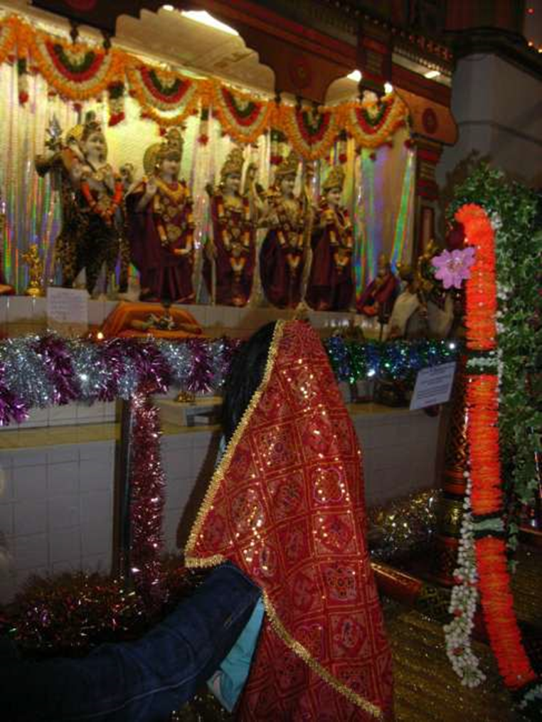
Puja Worshipping God at a Hindu shrine. This could be at home or in a Mandir.

Slide 5
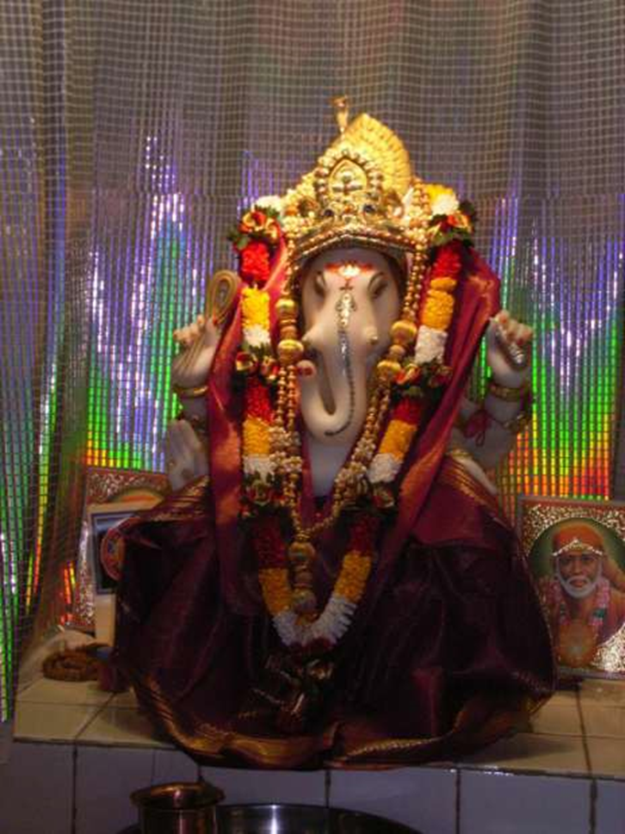
Ganesh: A Hindu image of God, shown with an elephant’s head – a sign that God is kind, strong and wise.

Slide 6
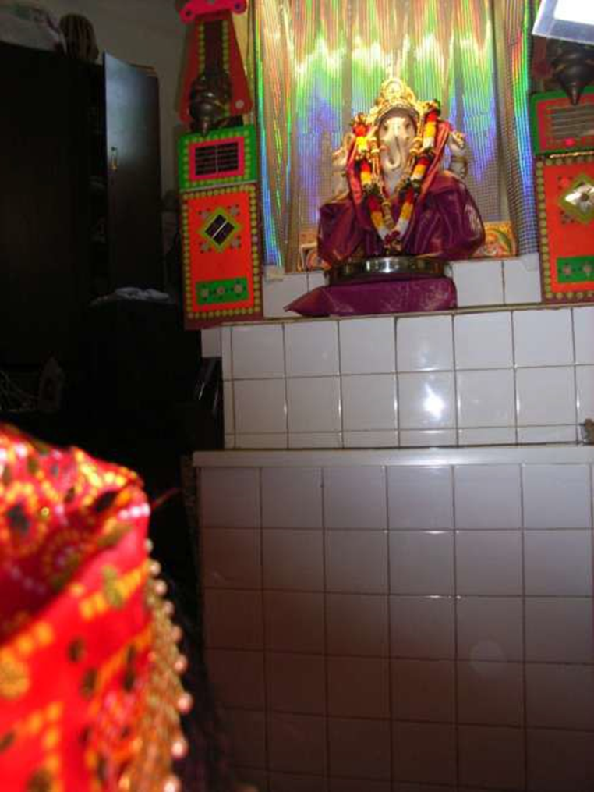
Murti:
An image of God – usually a statue.

Slide 7
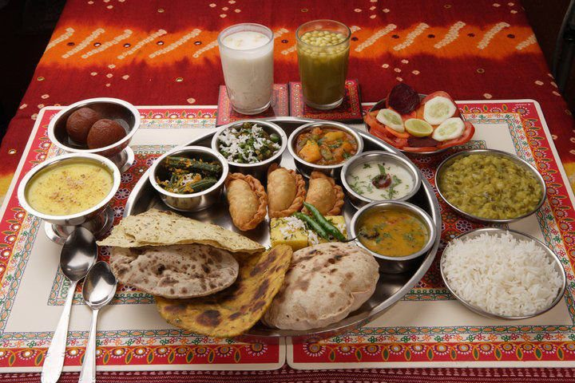
Prasad:
Food for sharing that has been blessed; usually sweets or fruit.

Slide 8
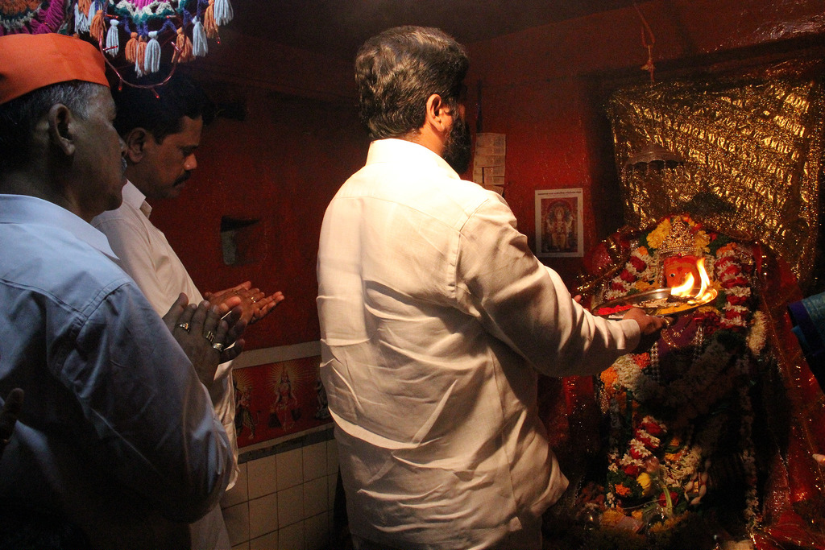
Arti
A lamp (or incense) is waved in front of the image (murti) as a way of welcoming the God or Goddess

