Slide 1
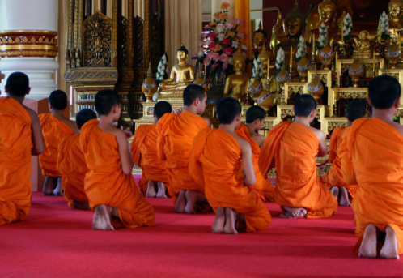
Theravada Buddhism
(Often called southern Buddhism)

Slide 2
“It is good to have few expenses and few possessions.”
What does this mean?
Do you agree?

Slide 3
Objectives:
Understand where Theravada Buddhism is found.
By revisiting the map from last lesson.
Know what the life of a Buddhist monk is like.
By watching a film and using the information to empathise with their lifestyle.
To explore how Theravada Buddhists express their faith.
By explaining how the monks relate to the wider community.

Slide 4
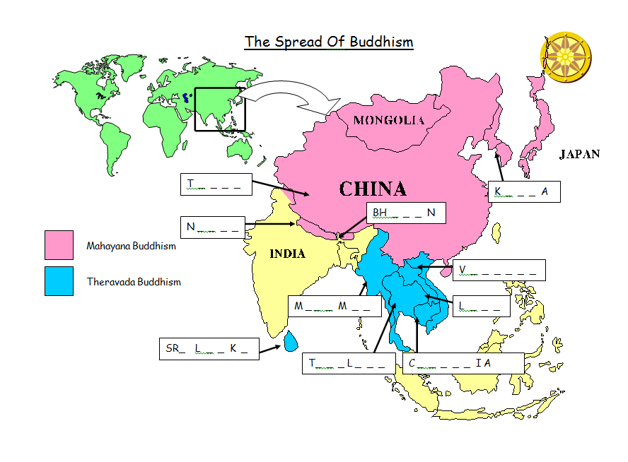
Turn to this map from last lesson

Slide 5
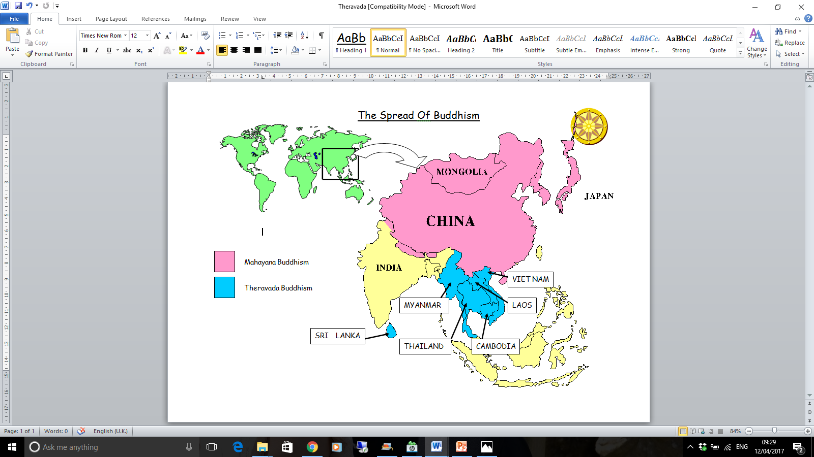
WE ARE LOOKING AT THIS AREA TODAY

Slide 6
Objectives:
Understand where Theravada Buddhism is found.
By revisiting the map from last lesson.
Know what the life of a Buddhist monk is like.
By watching a film and using the information to empathise with their lifestyle.
To explore how Theravada Buddhists express their faith.
By explaining how the monks relate to the wider community.

Slide 7
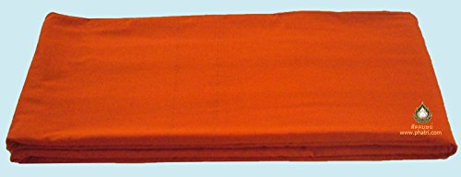
What is this?
A folded Monk’s robe

Slide 8
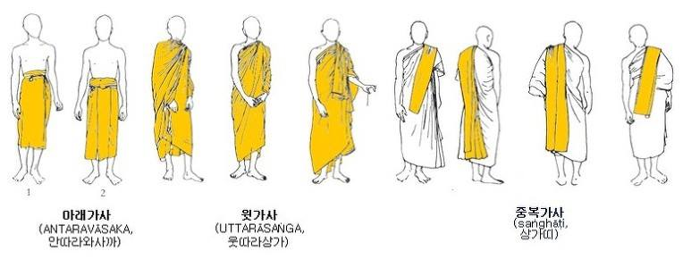
How to wear Thai Buddhist robes

Slide 9


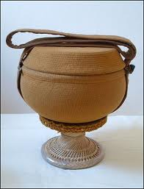
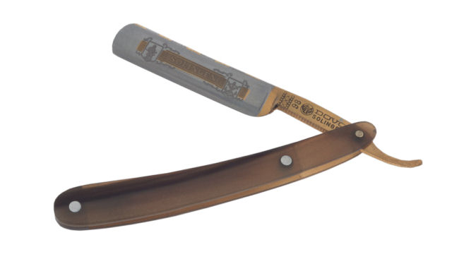
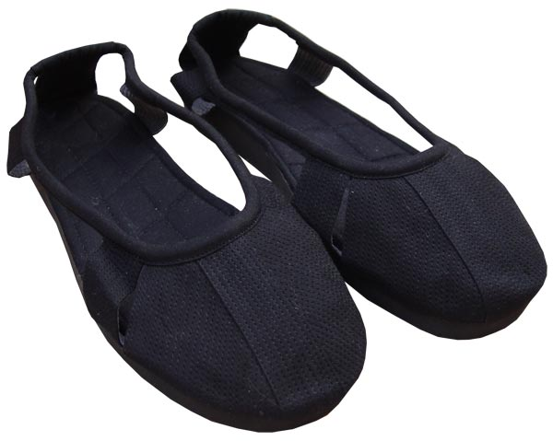
A Theravada Monk’s Possessions… all of them!

Slide 10
What are your favourite possessions?

Slide 11
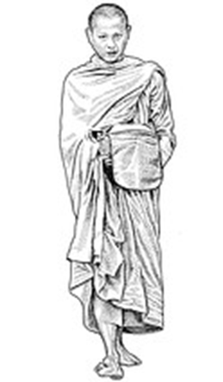
LO: To explore how Theravada Buddhists express their faith.
Writing activity 1:
  Stick in your picture of the Theravada Monk right in the middle of one page.
  Write down all of their possessions around the picture and explain how they use them.
  Explain why the monks have so few possessions.

Slide 12
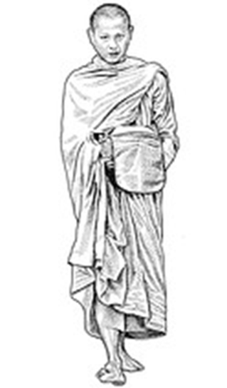
Alms Bowl:
Outer robe:
Razor:
Inner Robe:
They have so few possessions because:
Sandals:

Slide 13
Writing activity 2:
  Draw a quick sketch of yourself (could be just an outline shape like a gingerbread biscuit)
  Highlight the possessions that are essential (the ones you could not live without)
  How many essential items do you have?

Slide 14
Vinaya Precepts (Extra rules for monks)
Write these down and explain: Why do you think there are these specific extra rules for monks?
Not harming living beings
Not taking what is not freely given
Not committing sexual misconduct
Not using false speech
Not taking drink or drugs that cloud the mind
To refrain from eating after midday.
To refrain from dancing, singing, music, going to see entertainments.
To refrain from wearing garlands, using perfumes, and beautifying the body with cosmetics.
To refrain from lying on a high or luxurious sleeping place.
To refrain from accepting gold and silver (money).

Slide 15
Day in the life of a Buddhist monk
Day in the life
Write down the things you see that the monks do in a typical day. (these are the rough times from the film)
4am:
7am:
10am:
11am: Lunch
1pm:
5pm:
9pm:
11pm:

Slide 16
Objectives:
Understand where Theravada Buddhism is found.
By revisiting the map from last lesson.
Know what the life of a Buddhist monk is like.
By watching a film and using the information to empathise with their lifestyle.
To explore how Theravada Buddhists express their faith.
By explaining how the monks relate to the wider community.

Slide 17
So why become a monk?
Most people do not, but some families put one or more of their sons into be a monk.
They are following the path of Siddartha Gautama to enlightenment so they do not have another life of Dukkha and reach Nirvana.
They get an education in the Buddhist school.
Their family gain “merit” which will mean a better rebirth for them in the next life, a way of removing karma.

Slide 18
Writing task 4
Imagine one of you friends has decided to become a Bhikku / Bhikkuni, write a letter to them to dissuade them from joining, giving at least 3 reasons, relate these to the rules and lack of possessions.
Then write their response explaining why they think it is important to join.

Slide 19
Objectives:
Understand where Theravada Buddhism is found.
By revisiting the map from last lesson.
Know what the life of a Buddhist monk is like.
By watching a film and using the information to empathise with their lifestyle.
To explore how Theravada Buddhists express their faith.
By explaining how the monks relate to the wider community.

Slide 20
Plenary
Which of the extra 5 precepts for monks would you find the hardest to follow ?

